Slide 1
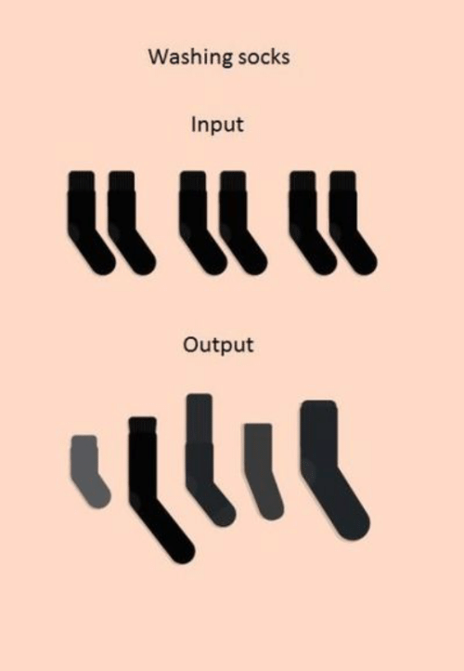
Basic Input/output
Load data and save your results

Slide 2
Topics
Introduction: GUI and basic calculations
Coding 1: Scripts, style, and variable classes
Coding 2: Control statements and loops
Visualization 1: Basics, subplots, get and set
Coding 3: Functions
Visualization 2: Descriptive plots
Coding 4: Basic input and output
Visualization 3: Distribution and 3D plots
Coding 5: Input and output specials – last lecture before holidays
Machine Learning 1: Introduction and dimension reduction
Machine Learning 2: Clustering
Machine Learning 3: Classification
Coding 6: Efficiency and debugging basics
Coding 7: Advanced functions and debugging

Slide 3

Input
Copy & Paste txt into script
Yeah…
Load .txt files
Load .mat files
Loads a MATLAB data file into the workspace
data = load(‚filename‘) stores as a struct
Works also without ()
Uigetfile gives you a filename and filepath to load
Csvread reads comma-separated values
Dlmread reads with specifieable delimiters
Xlsread reads Excel, gives [numbers, text, raw_cell]

Slide 4
Output
Save(filename), save(filename,variables)
Saves entire workspace or specified variables into .mat file
Works also without ()
Csvwrite writes comma-separated values
Dlmwrite writes with a specifieable delimiter
Xlswrite writes Excel files, needs Excel installed

Slide 5
Complex File Reading
fopen, fprintf, fclose
Powerful and complex file writing operators
Open file, get an ID, write into the file, close (finalize) the file
Fopen, feof, fgetl, sscanf, fclose
Powerful and complex file reading operators
Open file, get ID, check if already at the end of file, read a single line, convert according to format, close file

